Slide 1
CSOPESY OS Emulator System
Command Recognition, Console UI, Command Interpreter, Process Representation, Scheduler Implementation

Slide 2
Introduction
The CSOPESY OS Emulator is a simulation of an operating system environment with an emphasis on process management, scheduling, and interaction through a command-line interface.
It is designed to demonstrate essential OS principles such as command recognition, scheduling, process representation, and batch processing.

Slide 3
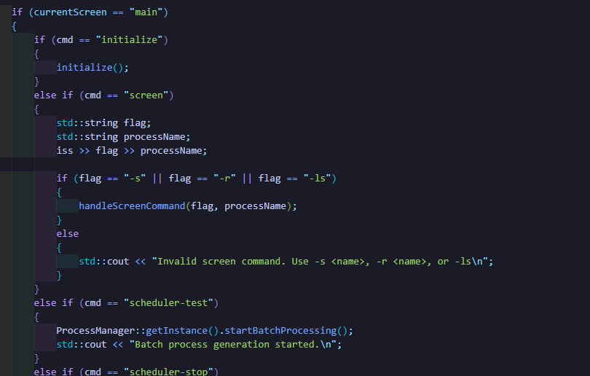
Command Recognition
The emulator supports a range of commands that initialize the system, manage processes, and display information. Each command is parsed and handled within the CLI class.

Slide 4
Detailed Command Recognition
The command recognition function is implemented in `CLI.cpp`. Here’s how it works:
1. **Parsing Commands**: The user input is parsed using an `istringstream`, breaking down the input to determine which command has been issued.
2. **Command Checking**: Each recognized command has a dedicated handler. For example, the `initialize` command calls a system initialization routine.
3. **Invalid Commands**: If an unrecognized command is entered, the system notifies the user of the invalid input.
This structure provides flexibility and enables easy expansion of command options.

Slide 5
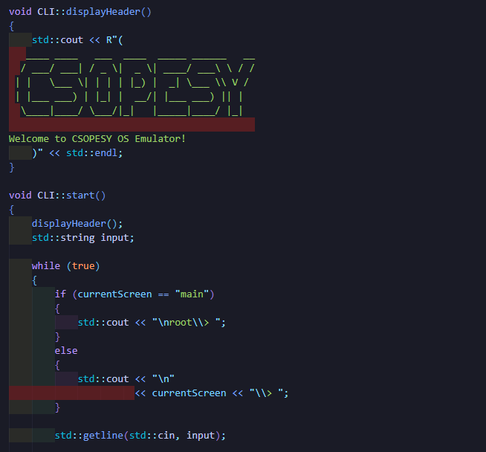
Console UI Implementation
The Console UI provides an interface that facilitates interaction with the OS emulator.
Key components include a welcoming header, screen transitions, and clear prompts depending on the user’s location in the interface.

Slide 6
Detailed Console UI Implementation
1. **Display Header**: Upon startup, the `displayHeader()` function displays a welcome message using ASCII art.
2. **Screen Transitions**: The `clearScreen()` function clears the console and transitions to a new screen for specific commands.
3. **Process-Specific Screens**: The `displayProcessScreen()` shows detailed information for individual processes, making it easy to monitor and interact with them.

Slide 7
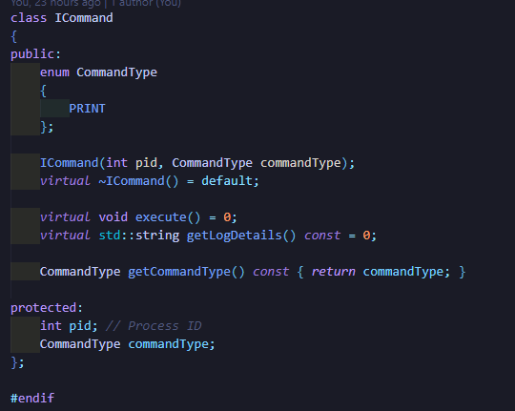
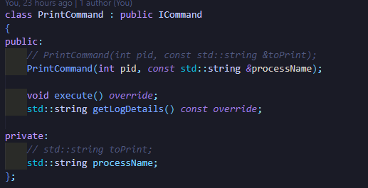
Command Interpreter Implementation
The command interpreter is the backbone of command execution in the OS emulator.
It establishes a base structure for defining and managing commands, with `ICommand` as the core class for command processing.

Slide 8
Detailed Command Interpreter Implementation
1. **Base Class (ICommand)**: `ICommand` serves as a virtual base class, specifying essential methods like `execute()` and `getLogDetails()`.
2. **PrintCommand**: An implementation of `ICommand`, `PrintCommand` is responsible for handling print operations for processes.
3. **Execution and Logging**: Each command logs actions, aiding in diagnostics and tracking system activity over time.

Slide 9
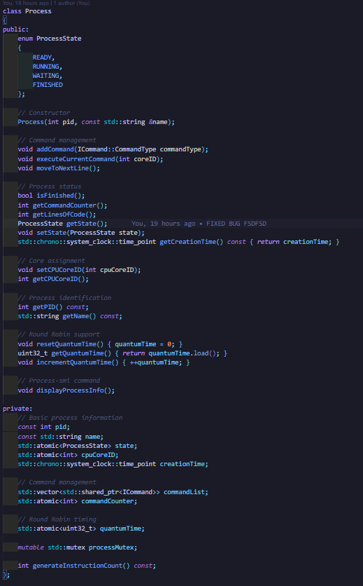
Process Representation
Processes are represented by the `Process` class, encapsulating attributes and methods for each simulated process.
Each process has a PID, state, CPU core assignment, and a list of commands to execute.

Slide 10
Detailed Process Representation Implementation
1. **Attributes**: `Process` maintains its ID, name, state, and CPU core assignment.
2. **Command List**: Each process includes a list of commands to execute.
3. **Quantum Management**: Implements Round-Robin quantum tracking using `quantumTime`.

Slide 11
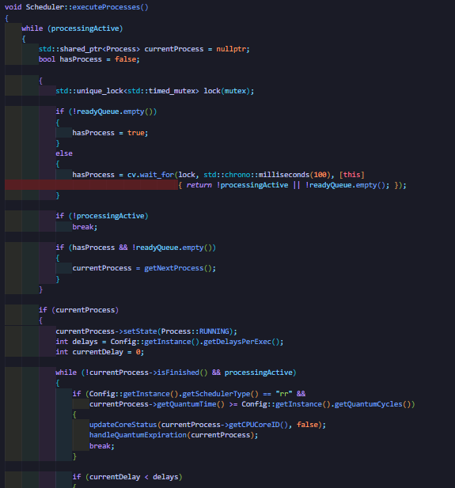
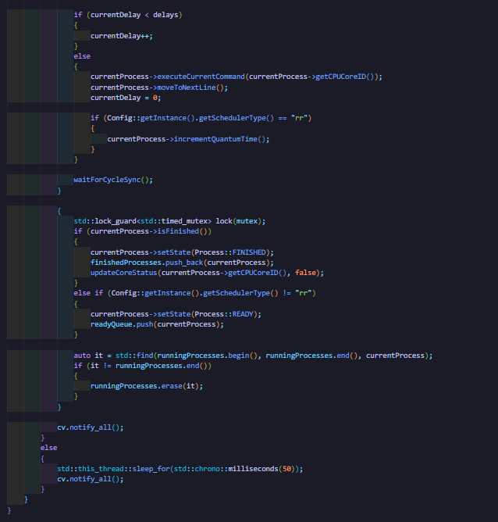
Scheduler Implementation
The scheduler manages the assignment of processes to CPU cores, supporting both First-Come, First-Served (FCFS) and Round-Robin scheduling algorithms.

Slide 12
Detailed Scheduler Implementation
1. **Queue Management**: The scheduler maintains separate queues for ready, running, and finished processes.
2. **Scheduling Algorithms**: Implements both `fcfsSchedule()` for FCFS and `roundRobinSchedule()` for Round-Robin scheduling.
3. **CPU Utilization**: The scheduler tracks core usage and generates a utilization report using `getCPUUtilization()`.

